Slide 1
Slide 1: Team Members
Book Recommendation System
Group - II Members:
K Mohammad
Mr. Mahesh Kumar Reddy
Ms. Varshitha .KS
Ms. Sanjana .NK
Mr Nikhil Manohar
Mr. Prathmesh Ravindra
Mrs Mehjabeen Noufal

Slide 2
Title: "Book Recommendation System Project - Group 2"
Subtitle: “Final PPT"
Your Name: K Mohammad
Date: 04/01/2024

Slide 3
Slide 3: Agenda
Brief overview of the topics to be covered.
I - Data Set Details
II - Exploratory Data Analysis (EDA)
Data Visualization
III - Model Building
Testing the model
IV - Model Deployment
V - Conclusion

Slide 4
I . Dataset Details

Slide 5
Books Dataset:
Purpose: This dataset contains information about various books, including details such as title, author, publication year, and publisher.
Key Attributes:
Book-Title
Book-Author
Year-Of-Publication
Publisher
Use Case: This dataset serves as the foundational information about the books available in the system. It helps in understanding the characteristics of each book and forms the basis for building the recommendation engine.

Slide 6
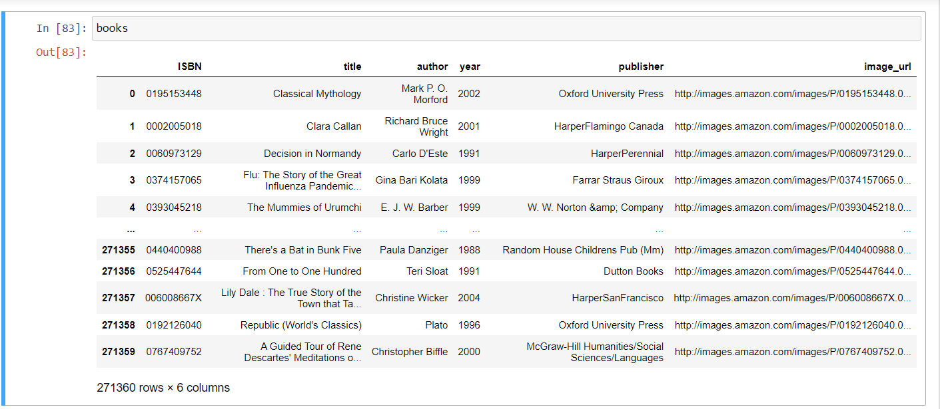

Slide 7
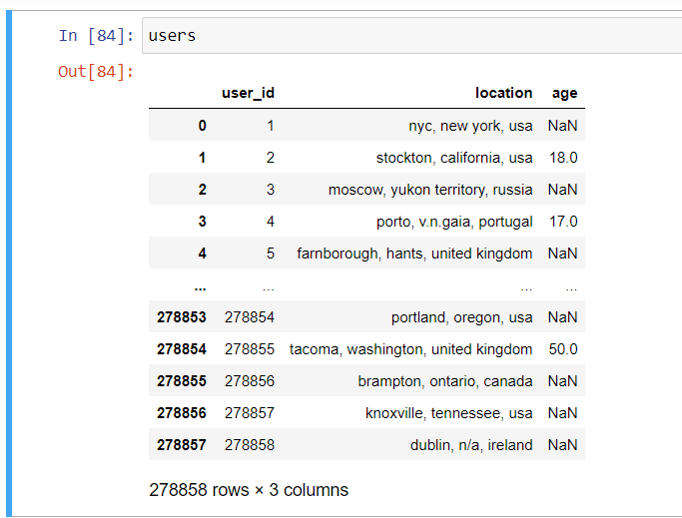
Users Dataset:
Purpose: The users dataset focuses on capturing information about the individuals engaging with the Book Recommendation System.
Key Attributes:
User-ID
Location
Age
Use Case: Understanding user demographics and preferences is essential for tailoring book recommendations. The dataset provides insights into the user base, aiding in the creation of personalized reading suggestions.

Slide 8
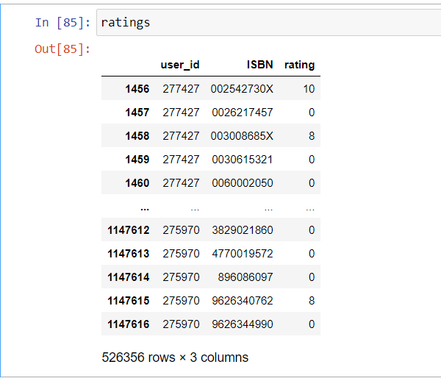
Ratings Dataset:
Purpose: This dataset records user ratings for various books, reflecting user preferences and opinions.
Key Attributes:
User-ID
ISBN (Book Identifier)
Rating
Use Case: The ratings dataset is crucial for training and evaluating the recommendation algorithm. It captures user feedback, allowing the system to learn and predict which books a user might enjoy based on their historical ratings.

Slide 9
II . Exploratory Data Analysis (EDA)

Slide 10
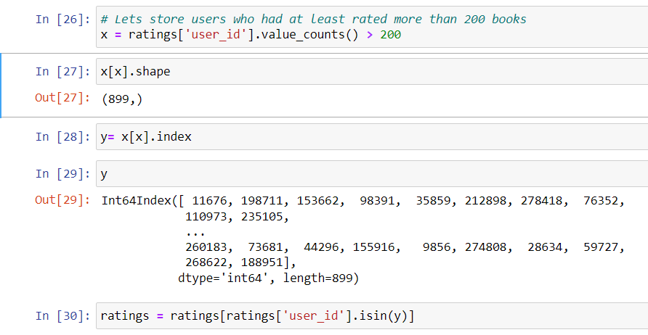
Step-1) Extract users and ratings of more than 200
when you run the above code we can see only 105283 peoples have given a rating among 278000. Now we will extract the user ids who have given more than 200 ratings and when we will have user ids we will extract the ratings of only this user id from the rating dataframe.

Slide 11
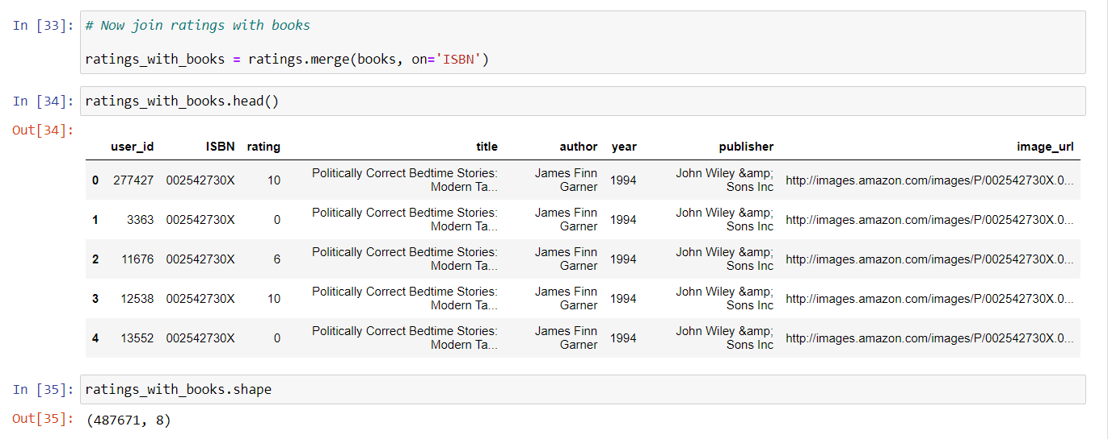
Step-2) Merge ratings with books
So 900 users are there who have given 5.2 lakh rating and this we want. Now we will merge ratings with books on basis of ISBN so that we will get the rating of each user on each book id and the user who has not rated that book id the value will be zero.

Slide 12
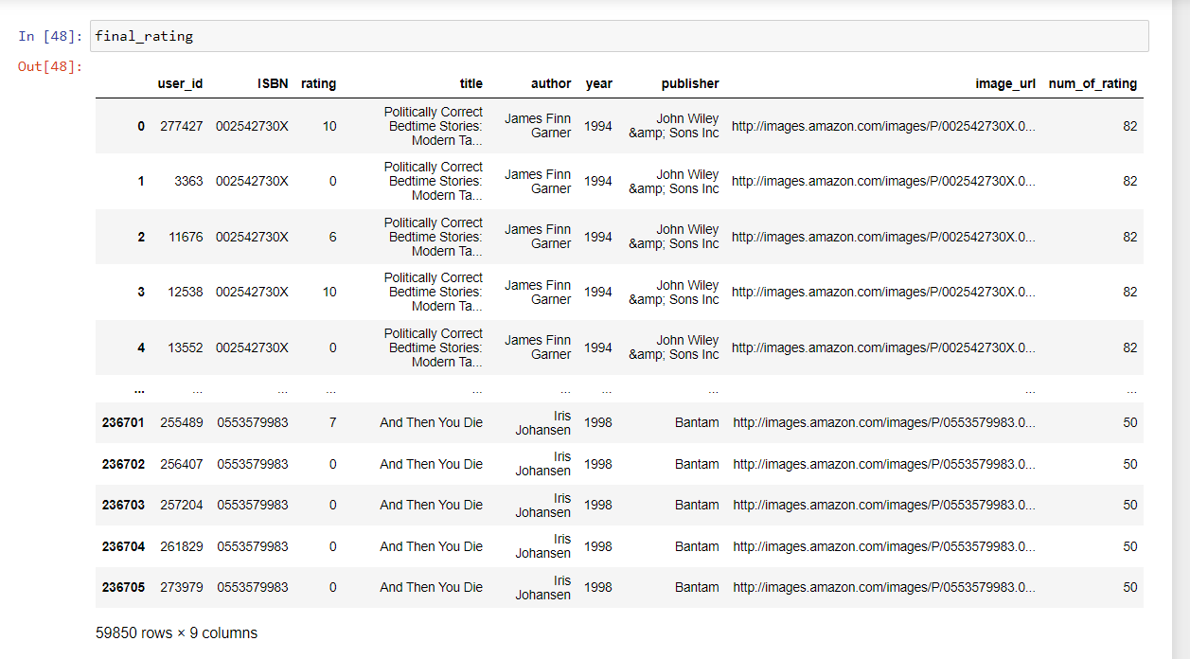
Step-3) Extract books that have received more than 50 ratings.
Now dataframe size has decreased and we have 4.8 lakh because when we merge the dataframe, all the book id-data we were not having. Now we will count the rating of each book so we will group data based on title and aggregate based on rating.

Slide 13
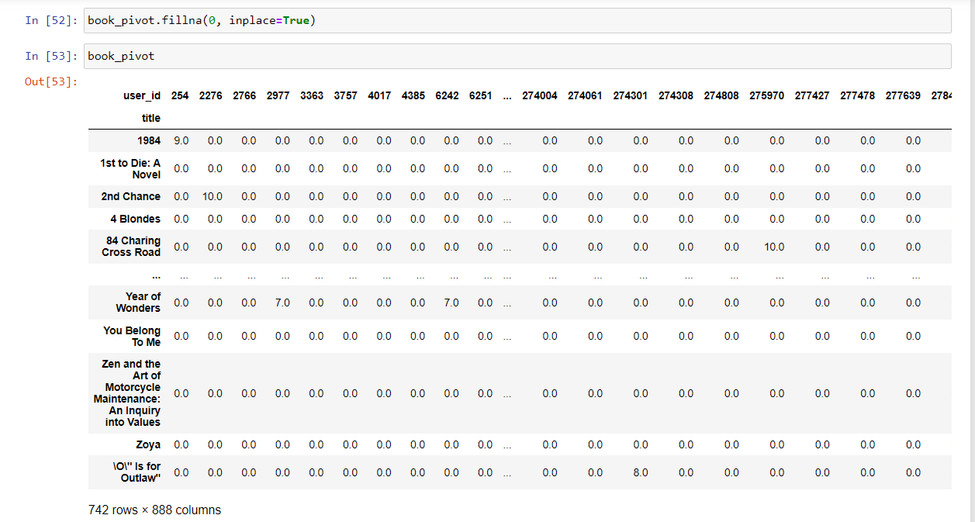
Step-4) Create Pivot Table
As we discussed above we will create a pivot table where columns will be user ids, the index will be book title and the value is ratings. And the user id who has not rated any book will have value as NAN so impute it with zero.

Slide 14
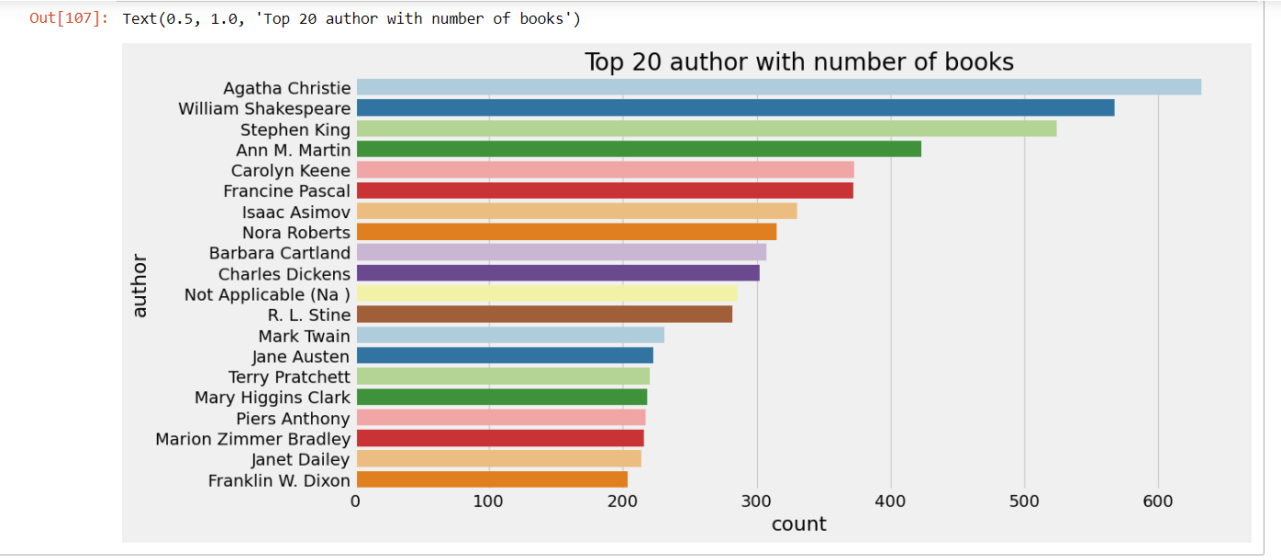
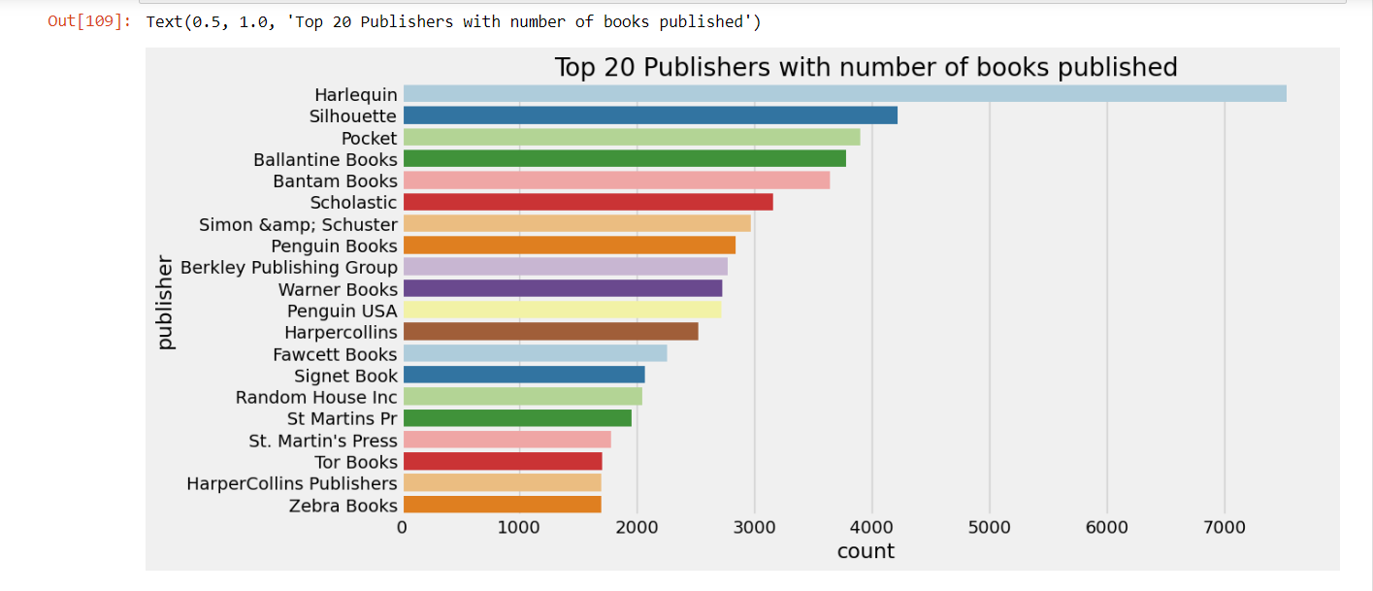
2.1 Data Visualizations Books Dataset Analysis -1

Slide 15
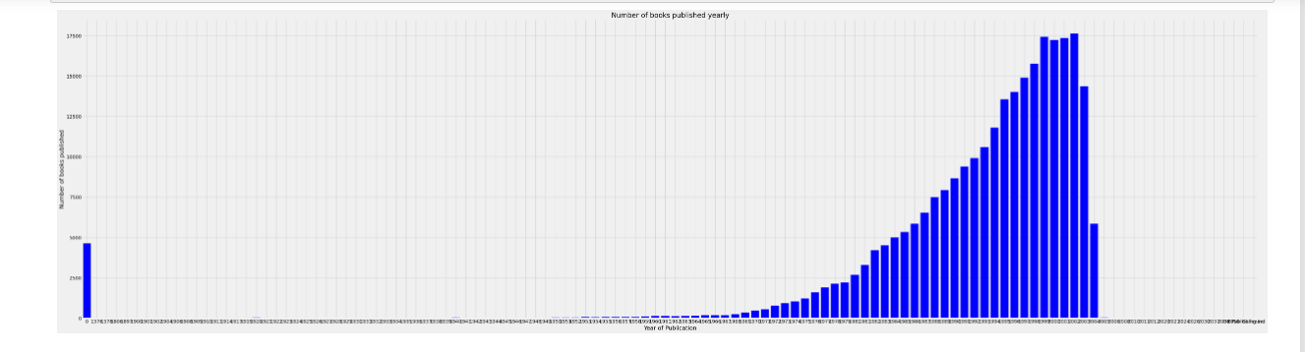

Slide 16
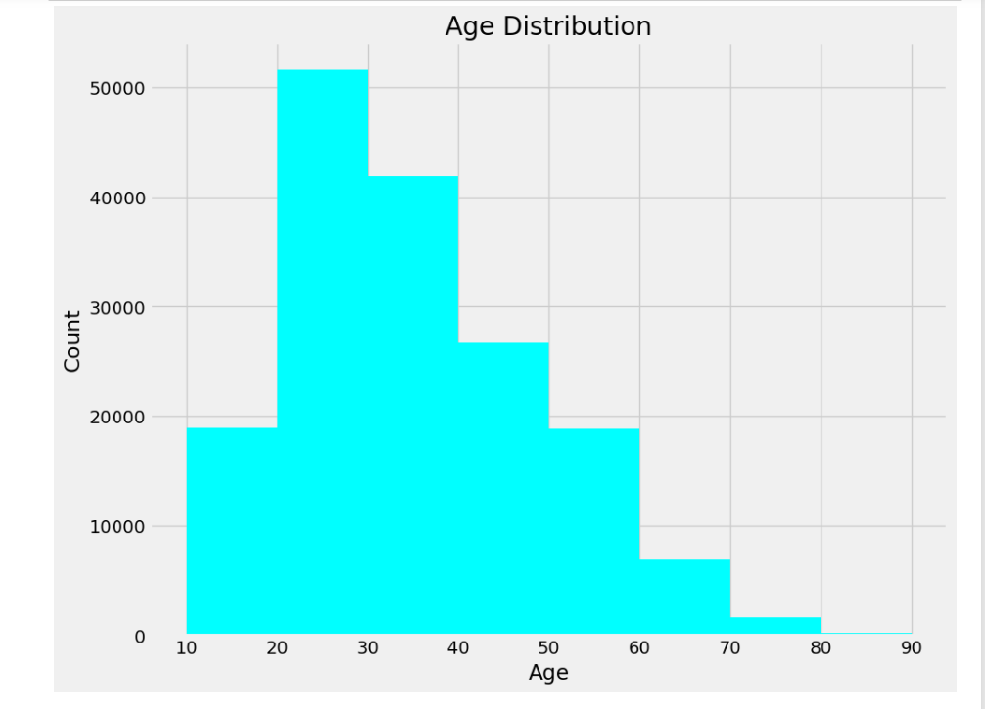
Users Dataset Analysis - 2

Slide 17
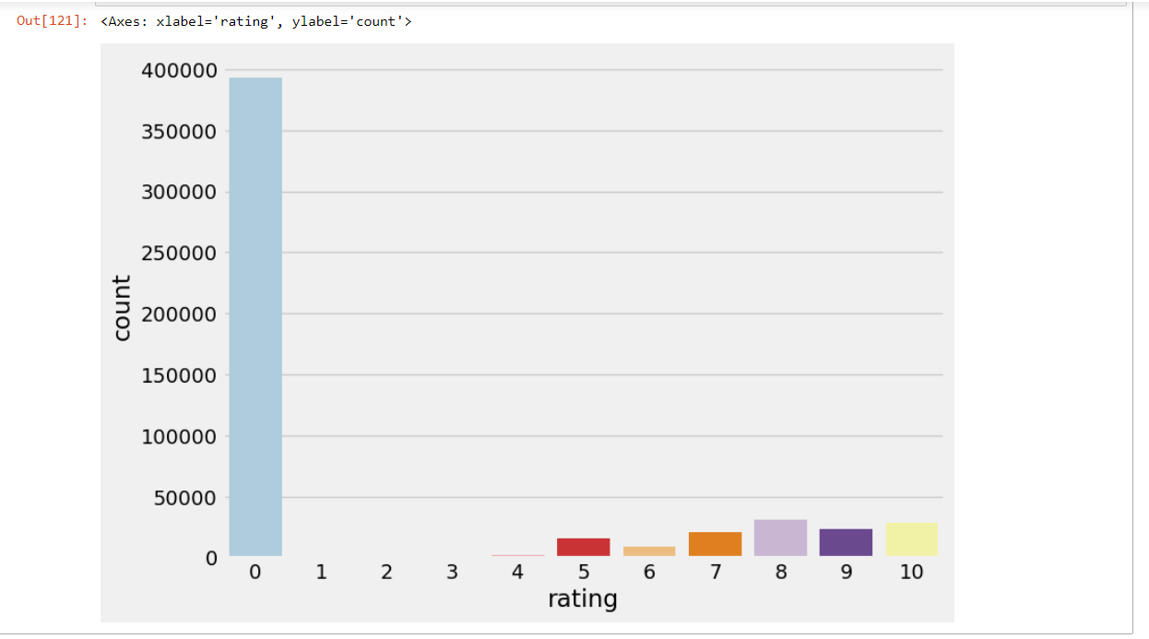
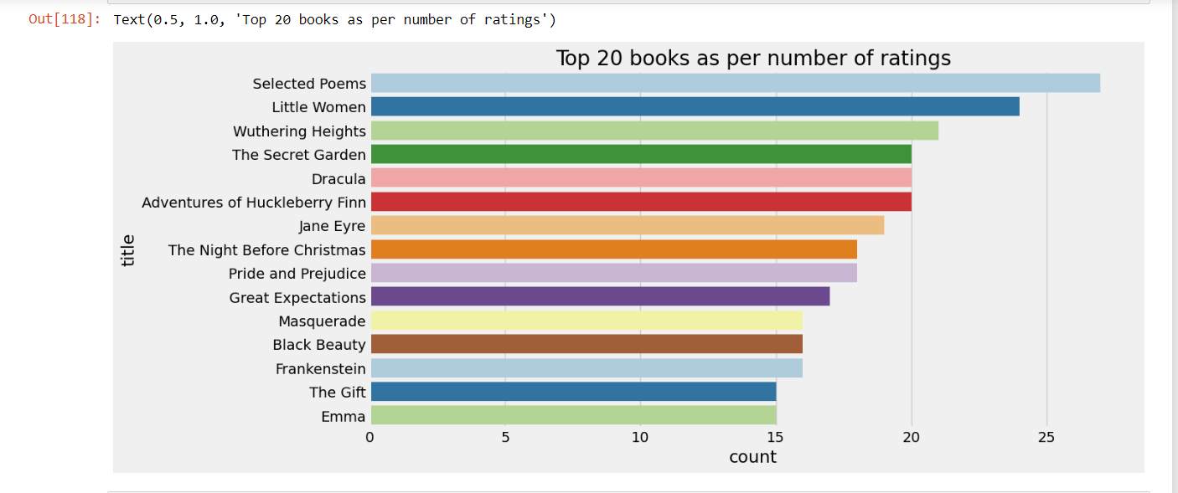
Ratings Dataset Analysis - 3

Slide 18
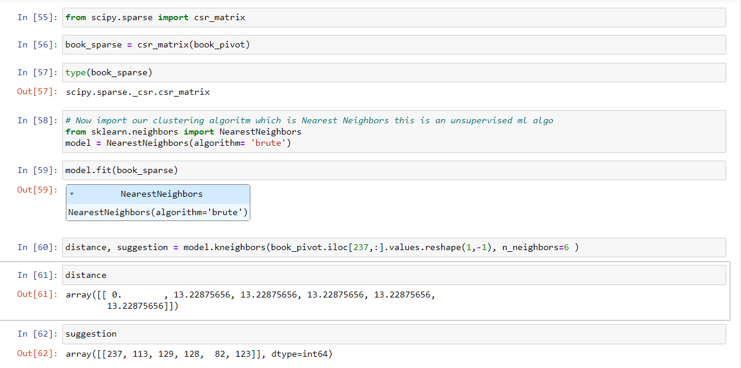
III – Model Building
But here in the pivot table, we have lots of zero values and on clustering, this computing power will increase to calculate the distance of zero values so we will convert the pivot table to the sparse matrix and then feed it to the model.
Now we will train the nearest neighbors algorithm. here we need to specify an algorithm which is brute means find the distance of every point to every other point.
Let’s make a prediction and see whether it is suggesting books or not. we will find the nearest neighbors to the input book id and after that, we will print the top 5 books which are closer to those books. It will provide us distance and book id at that distance. let us pass harry potter which is at 237 indexes.

Slide 19
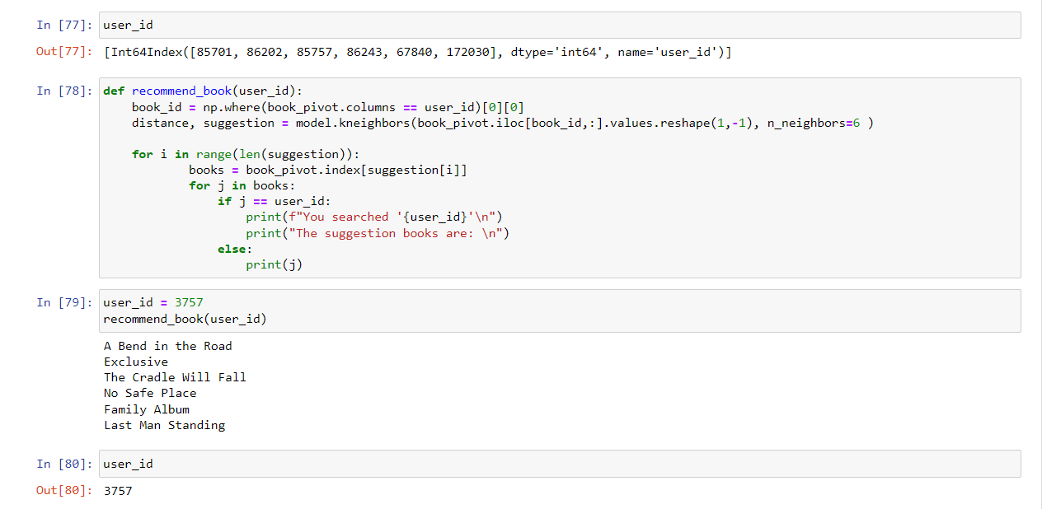
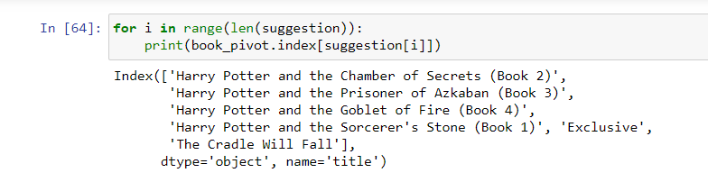
3.1 – Testing model

Slide 20
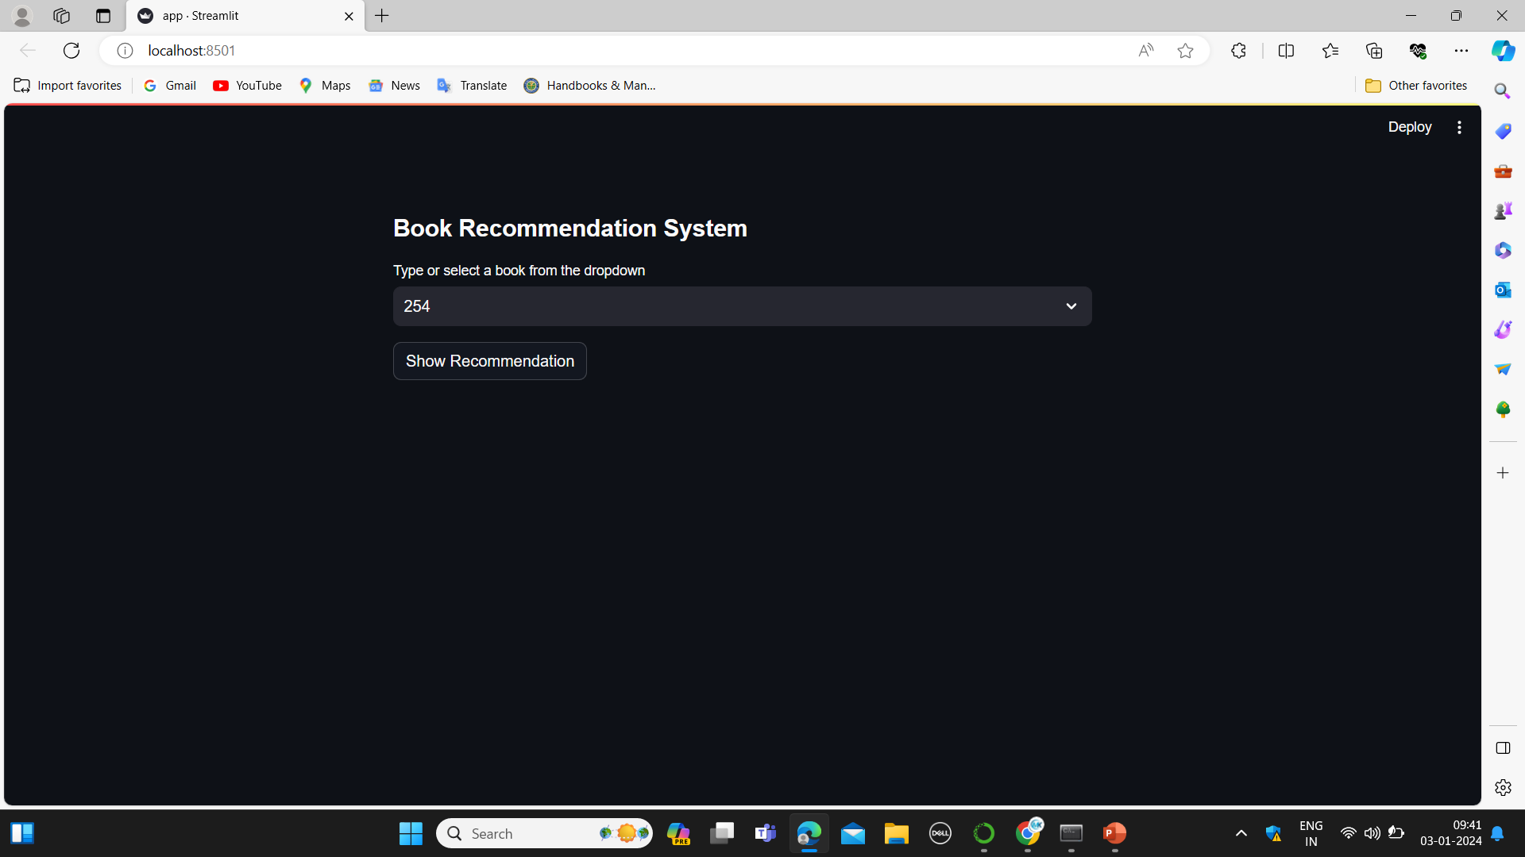
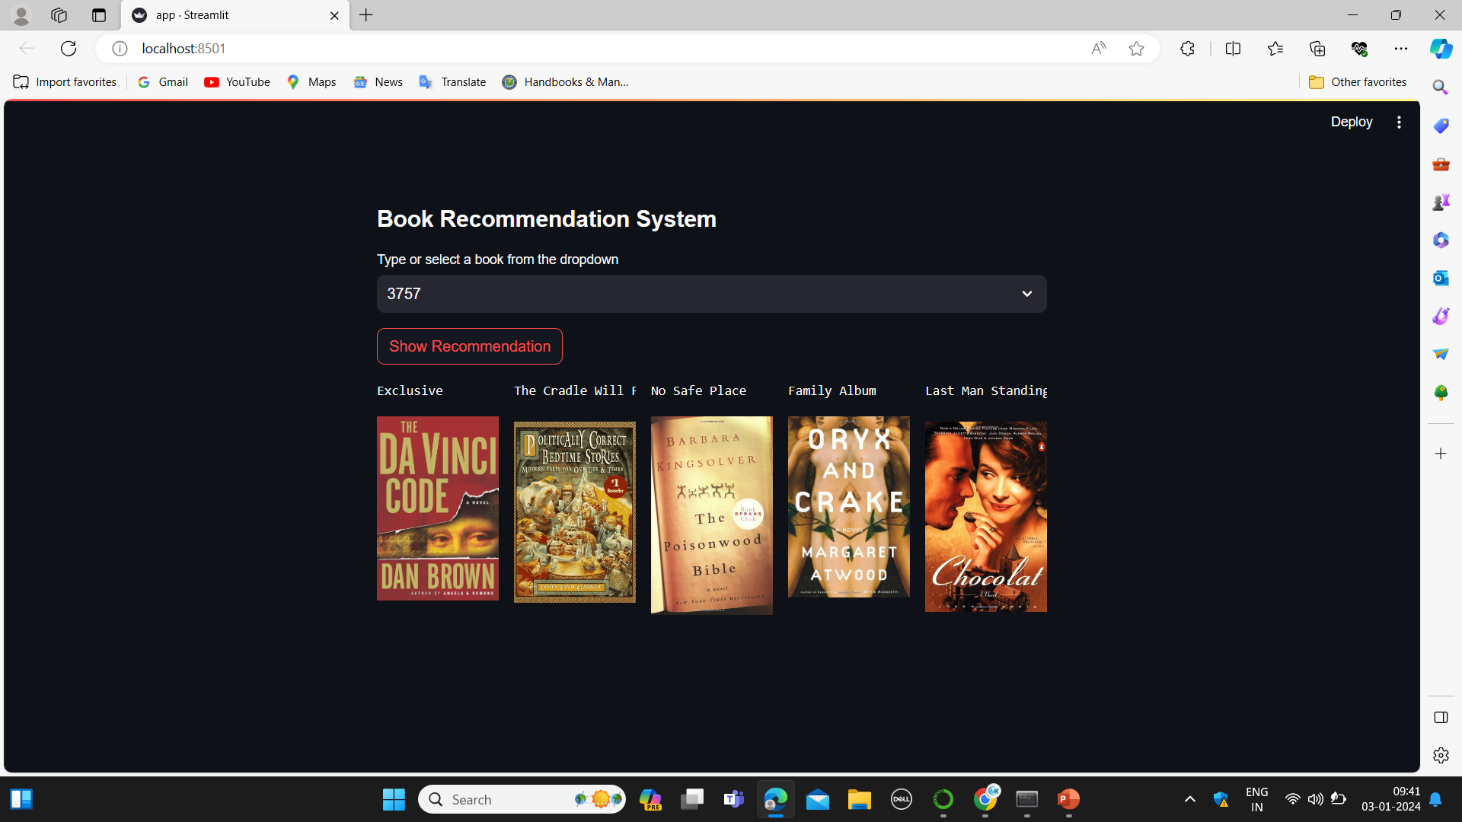
IV – Model Deployment

Slide 21
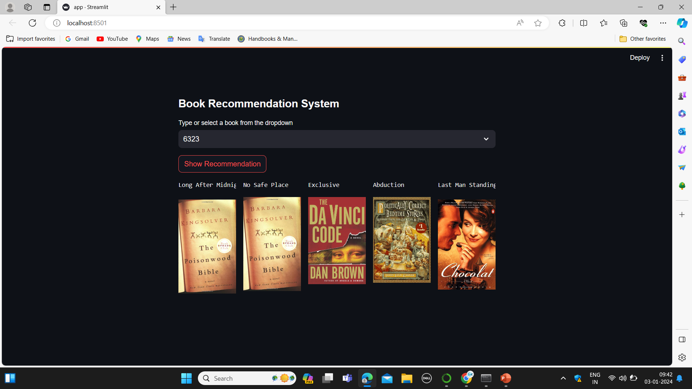

Slide 22
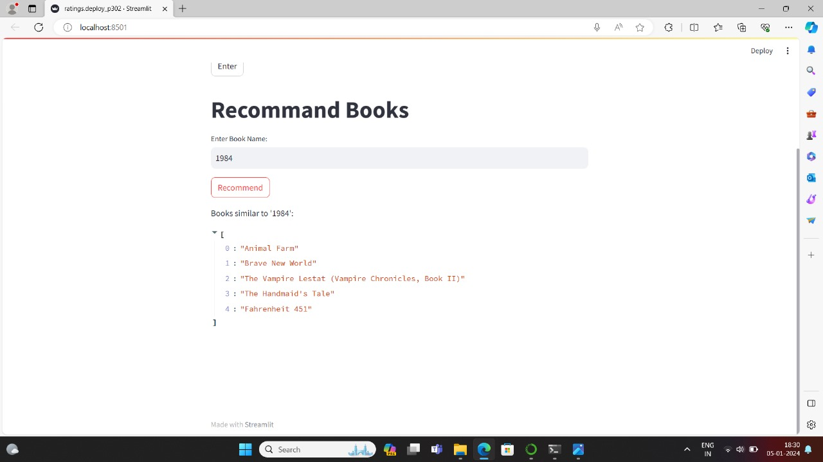
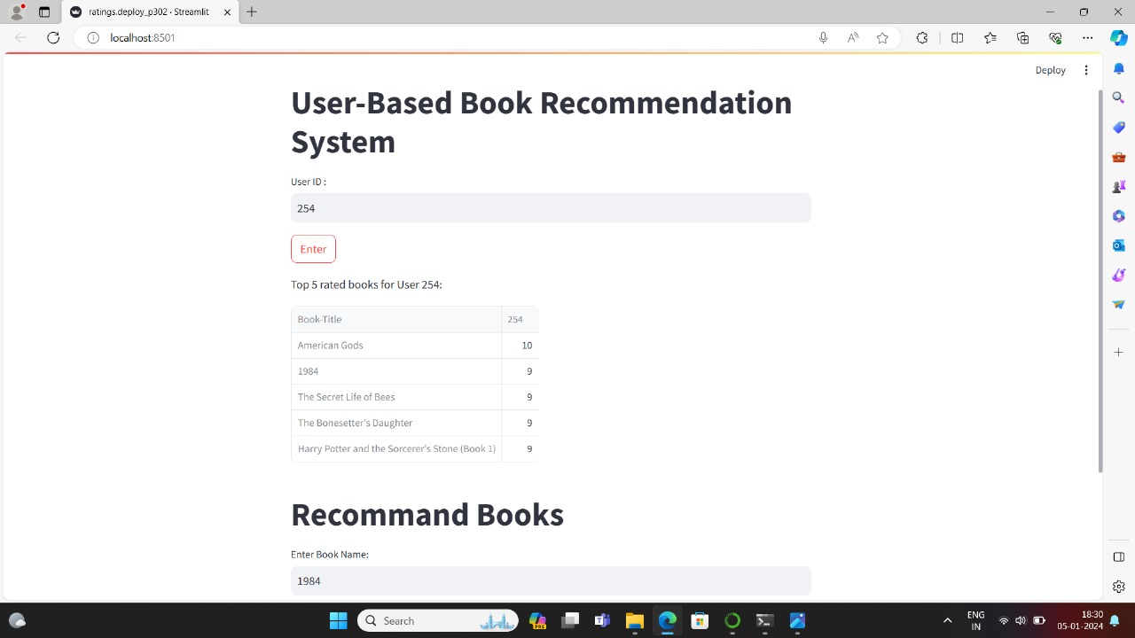
Deployment

Slide 23
V : Conclusion
As we conclude our Book Recommendation System project, we reflect on the pivotal role these datasets played in shaping a personalized and effective recommendation system.

Slide 24
Thank You

